Slide 1

PROJECT 2
STATEWISE HOSPITALS PERFORMANCE
DURING COVID-19

Slide 2
INTRODUCTION
This project is about state wise performance of covid 19 in public and private hospitals which is established through MySQL workbench.
MySQL is an open-source Relational Database Management System that stores data in a structured format using rows and columns. MYSQL language is easy to use as compared to other programming language like C, C++, Java, etc. By learning some basic commands we can work, create and interact with the Database.
In this presentation we will see how to import the table from excel, how to join different table using SQL functions and case statements

Slide 3

IMPORTING DATA FROM EXCEL
STEP 1
clean the data in excel and save as CSV file in the name of hospital_detail and covid_cases
STEP 2
go to mysql workbench and click new schema provide name as project 2 and click apply
STEP 3
the new schema in the name of project 2 is added in schema tab, right click the project 2 and click TABLE DATA IMPORT WIZARD
STEP 4
CLICK browse click hospital_det and finish the process by clicking apply
STEP 5
do the same process fro covid_cases file
STEP 6
from the schema tab click the table grid icon in hospital_det table,the table will imported successfully

Slide 4
TABLES USED
HOS_DET
Statewise_ins_id
States_in_india
State_id
Pub_hos
Pri_hos
Tot_hos
Pub_hos_gen_beds
Pub_hos_icu_beds
Pri_hos_gen_beds
Pri_hos_icu_beds
COVID_CASE
Statewise_ins_id
States_in_india
State_id
Population_data
Confirmed performance
Decesead_performance
Recovered_performance
Rank_bas_population

Slide 5
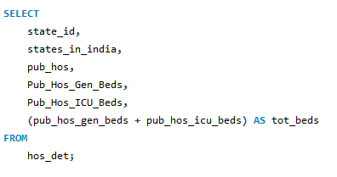
QUERIES
FETCH ALL THE DETAILS OF PUBLIC HOSITAL WITH TOTAL BEDS AVALIABLE

Slide 6
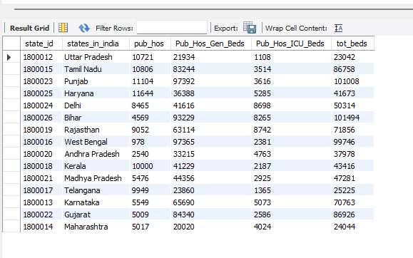
OUTPUT

Slide 7
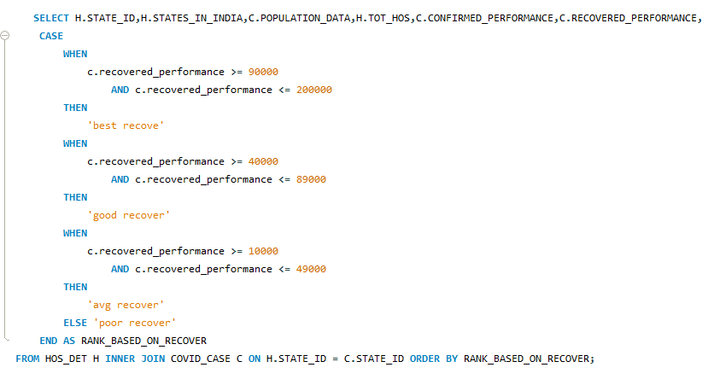
QUERIES
FETCH THE HOSPITAL DETAILS AND RECOVERED PATIENTS AND RANK THE STATE WISE HGHER NUMBER OF RECOVERY PAITENTS

Slide 8
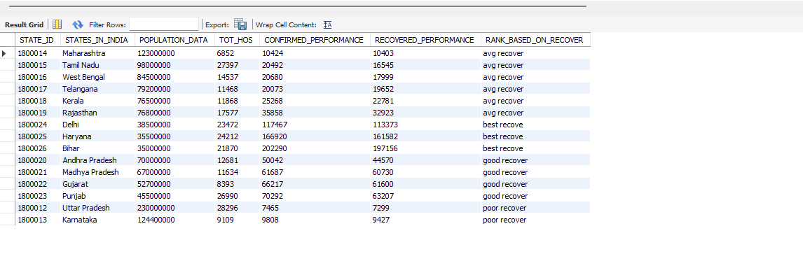
OUTPUT

Slide 9
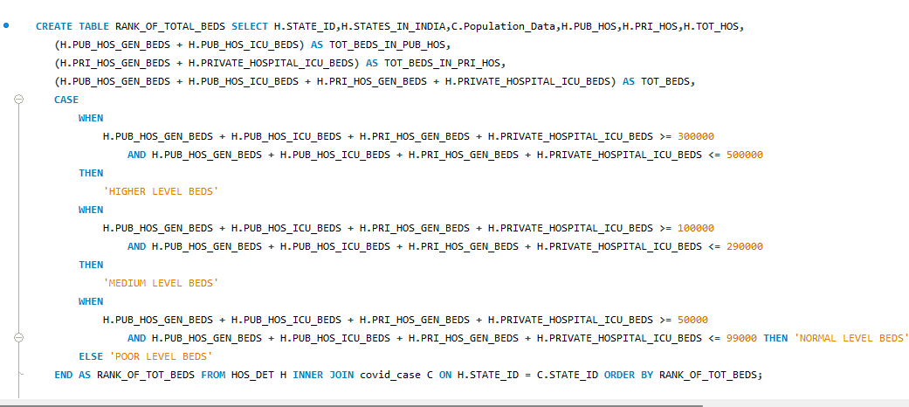
QUERIES
FETCH ALL THE DETAILS OF HOSPITAL AND RANK THE TOP STATE WHICH HAS MORE BEDS WITH POPULATION DATA AND CREATE TABLE IN THE NAME OF RANK_OF_TOTAL_BEDS

Slide 10
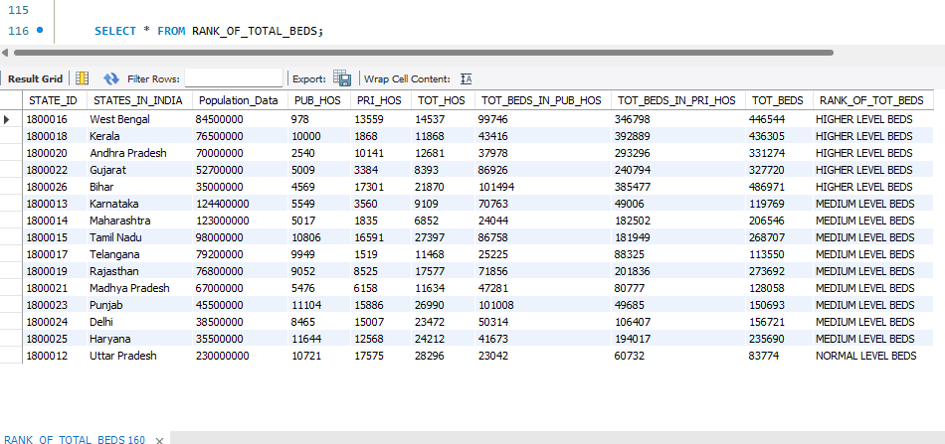
OUTPUT

Slide 11
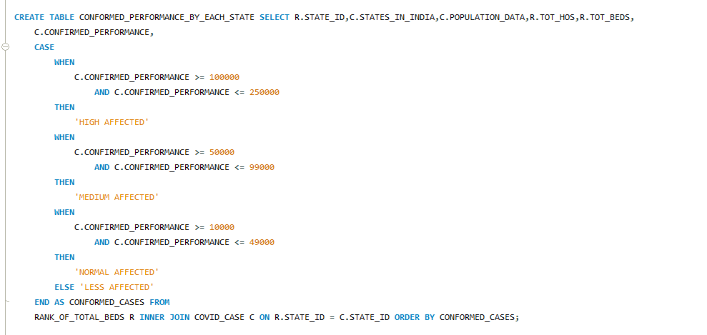
QUERIES
FETCH THE HOSPITAL BEDS DETAILS AND CONFIRMED PERFORMANCE OF EACH STATE AND RANK THE STATE WHICH HAS HIGHEST CONFORMED COVID CASES AND CREATE TABLE IN THE NAME OF CONFORMED_PERFORMANCE_BY_EACH_STATE

Slide 12
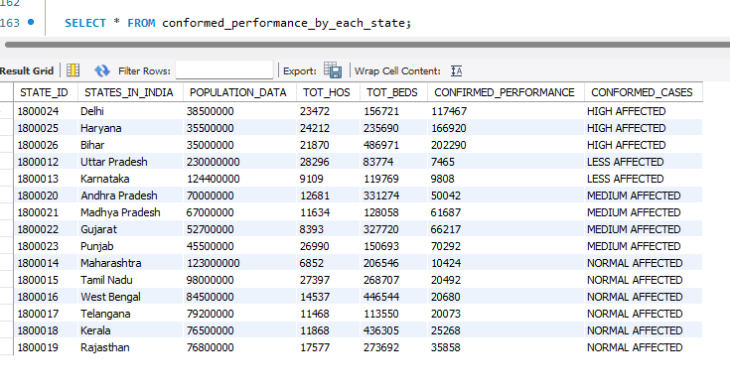
OUTPUT

Slide 13
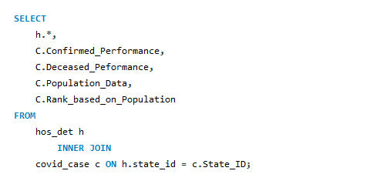
QUERIES
FETCH ALL THE DETAILS OF HOSPITAL AND COVID PERFORMANCE

Slide 14
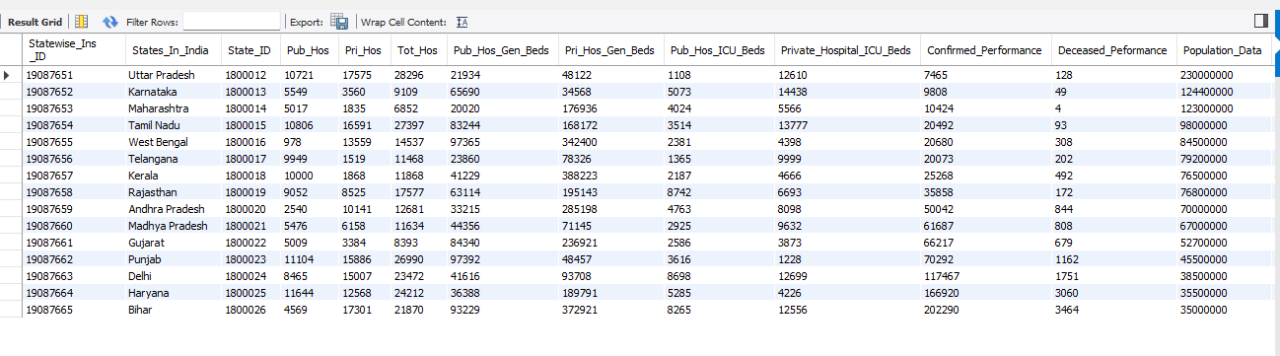
OUTPUT

Slide 15
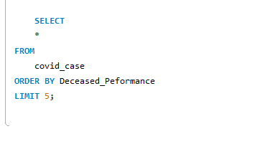
QUERIES
FETCH TOP 5 STATES WHICH HASE LOW NUMBER OF DECEASED_PERFORMANCE

Slide 16
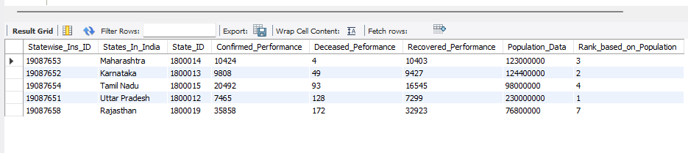
OUTPUT

